Slide 1

Plasma modeling in a tokamak
Miles Testa, Kieran McDonald, and Joe Roll

Slide 2
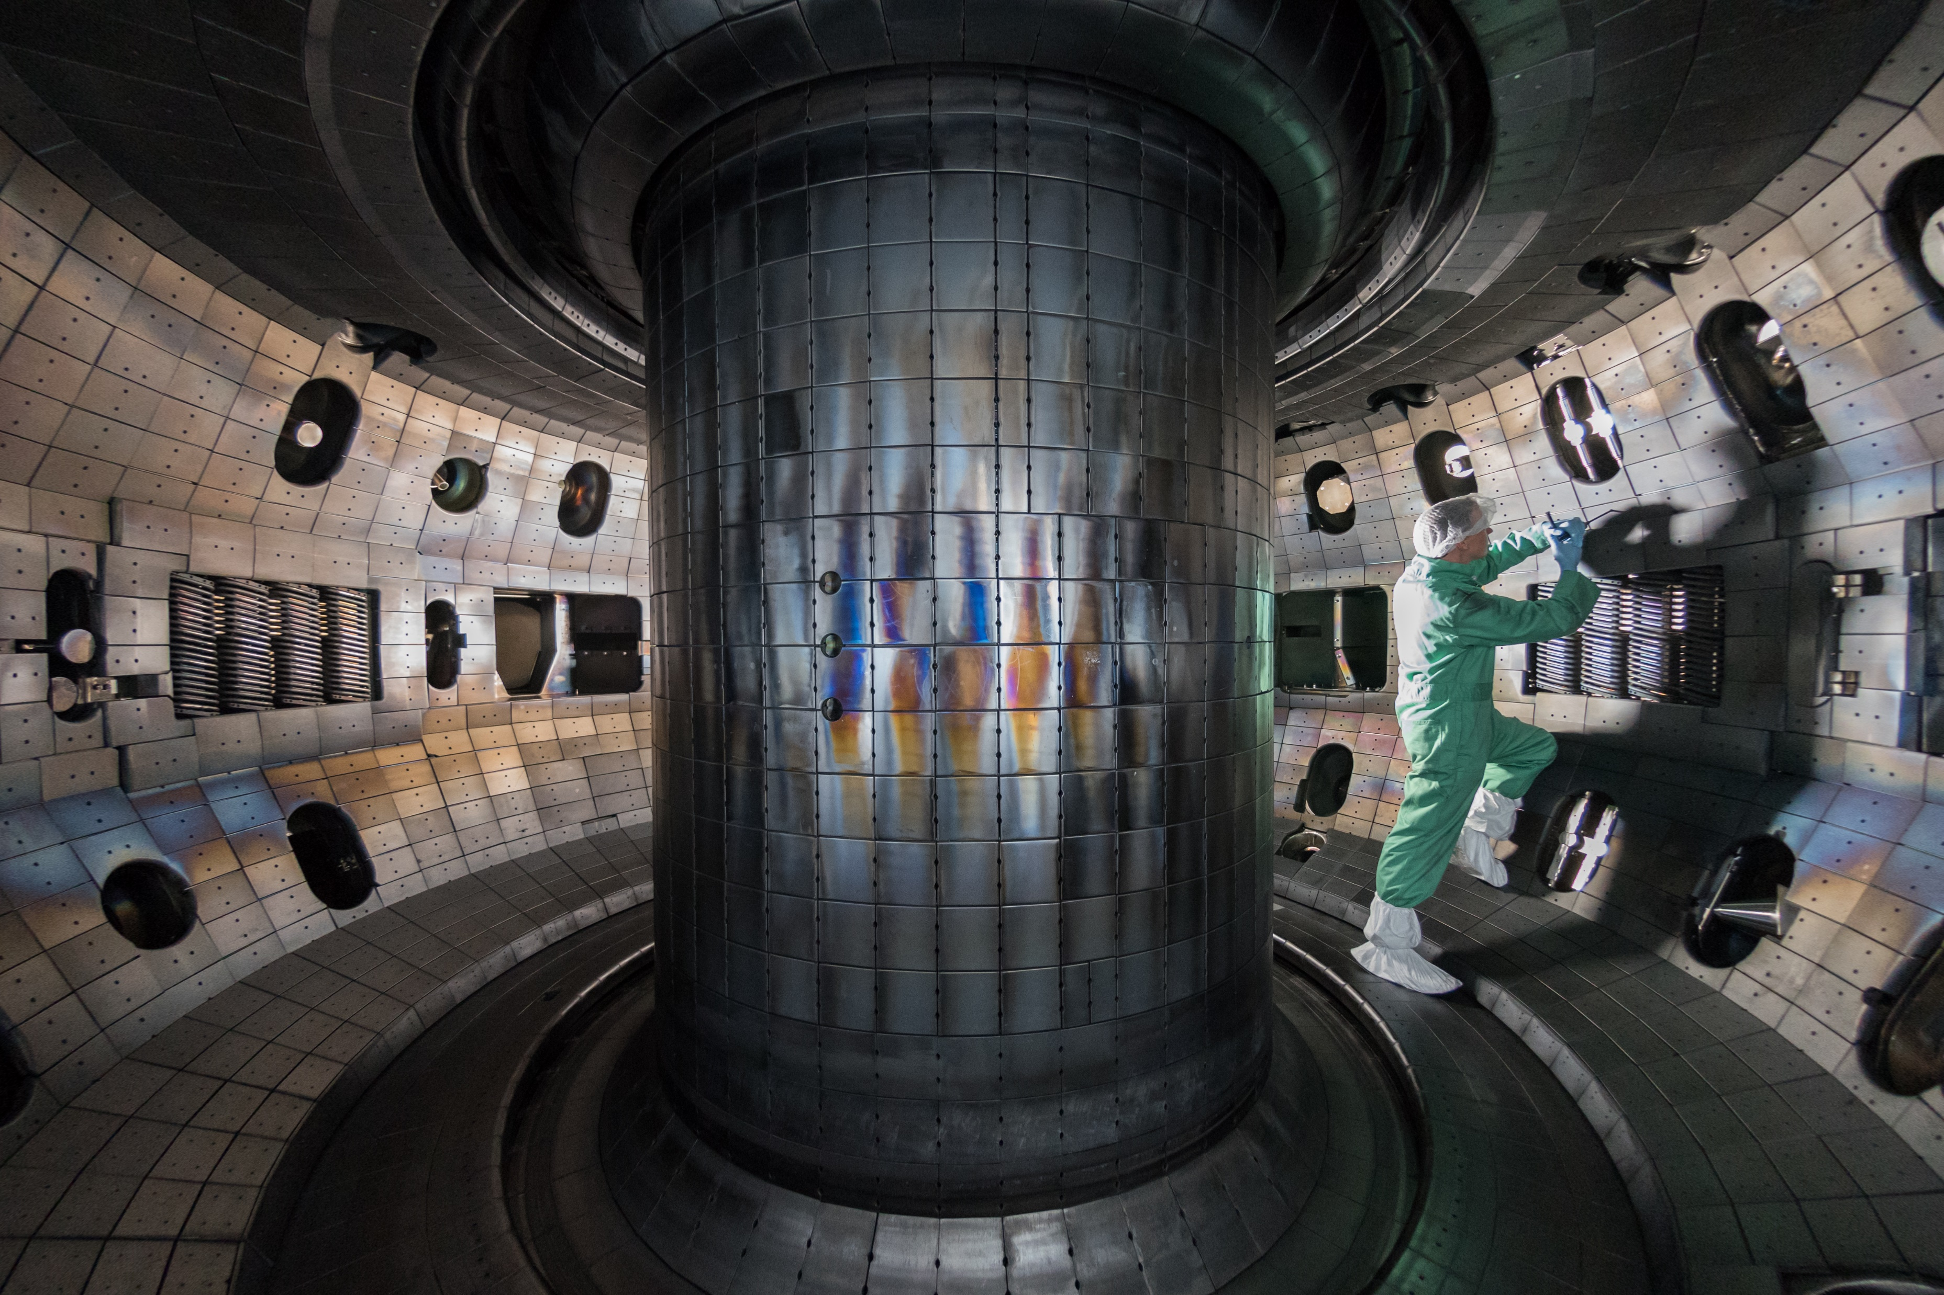
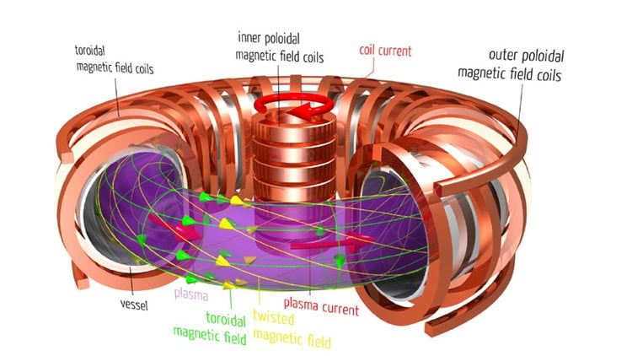
Plasma physics review
4th state of matter
Solid, liquid, gas, plasma
Fluid of ions (separated nuclei and electrons)
Experimentally studied in a tokamak
Traps plasma using magnets
Toroidally symmetric!

Slide 3
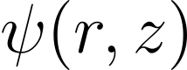
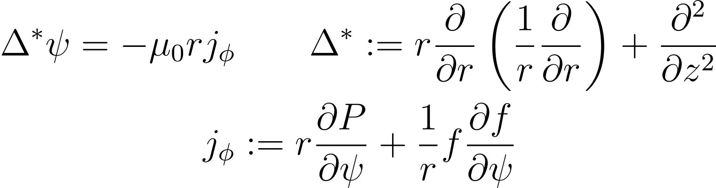
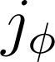
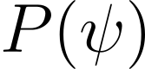
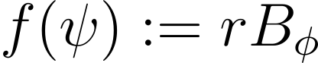
Plasma physics review
Poloidal magnetic field from the Grad-Shafranov (GS) equation
: Grad-Shafranov (toroidal) plasma current
: plasma pressure (arbitrary flux function)

Slide 4
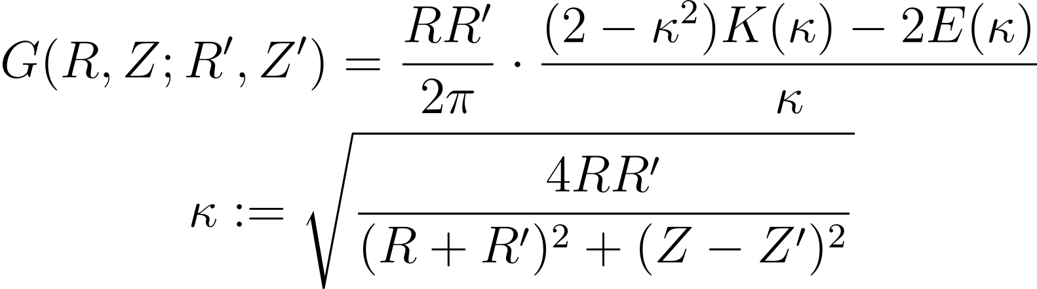
General approach
Plasma is contained in a last closed flux surface (LCFS)
We use a Green’s function approach to solve GS
Complete elliptic integrals

Slide 5
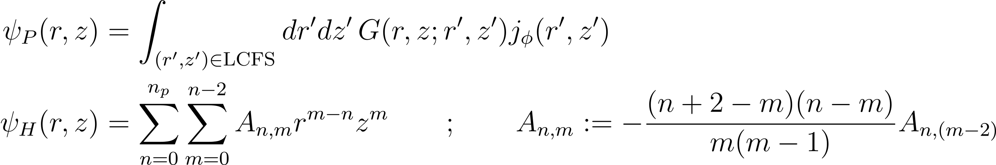
General approach
Flux from plasma
Flux from coils
Multipole expansion

Slide 6
Python implementation
Class structure with Numba
Customizable with the following parameters:
Numba challenges
Must declare array sizes to compile
Data types matter
No nested lists
Doesn’t support SciPy special functions (complete elliptic integrals)
Stored all values (~0.0001) in global arrays, called from within class
Plasma shape
Just within LCFS
Resolution
Minor radius | Major radius | Triangularity | Elongation | Just plasma
R dim | Z dim | R range | Z range | Number of poles

Slide 7
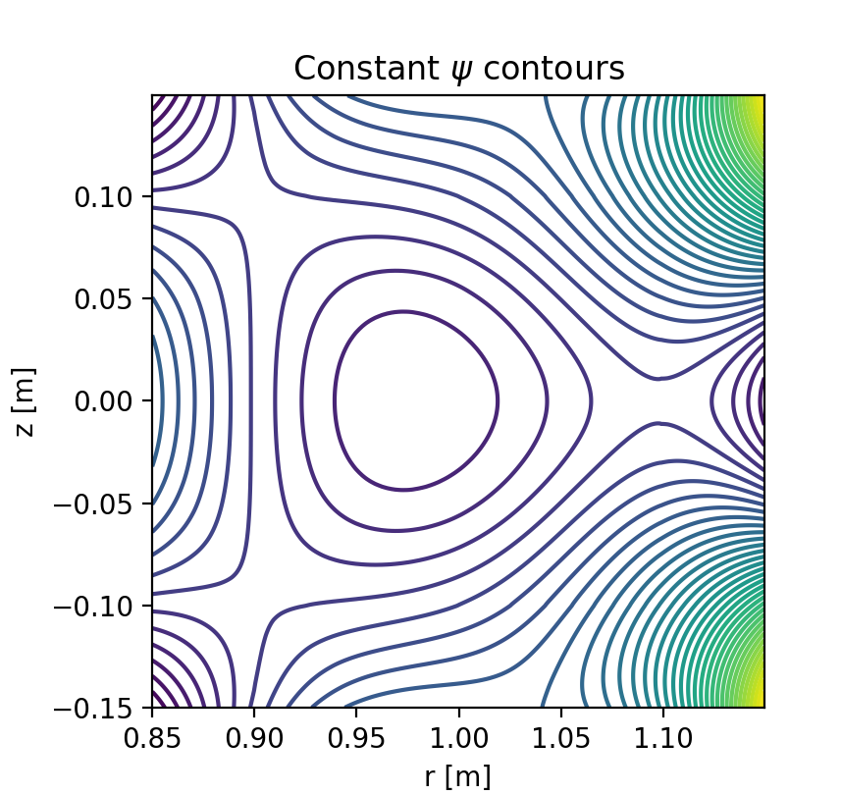
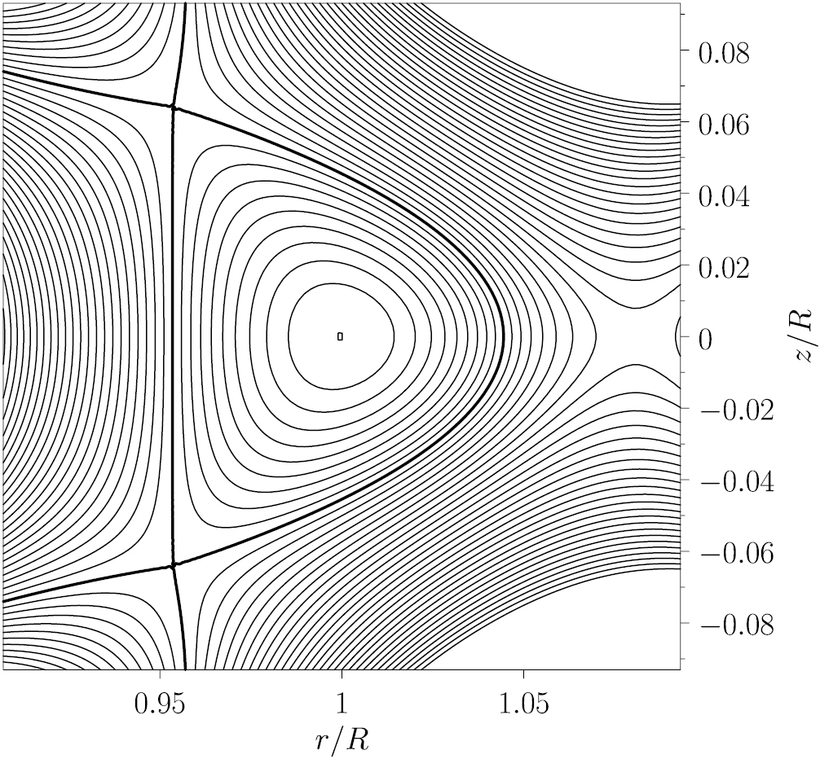
Computational results
T. Xu and R. Fitzpatrick Nucl. Fusion 59, 064002 (2019)
500 x 500 grid
Major radius = 1.0 m
Minor radius = 0.1 m
Triangulation = 0.8
Elongation = 1

Slide 8
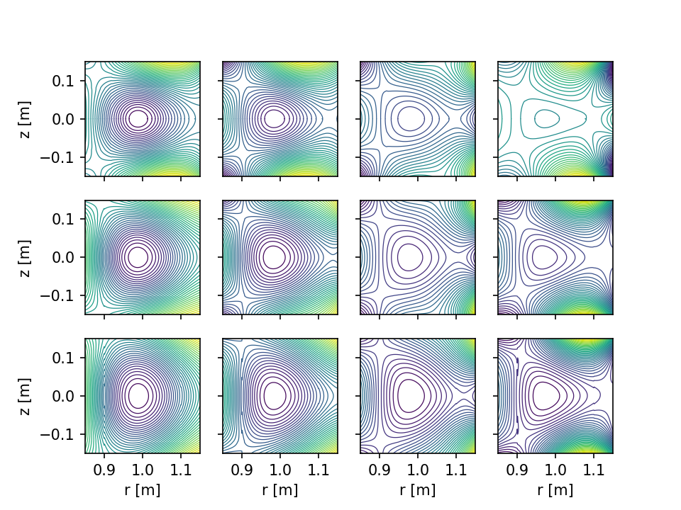
Computational results
Triangulation →
0.25
0.50
0.75
1.00
Elongation
→
0.80
1.00
1.20

Slide 9
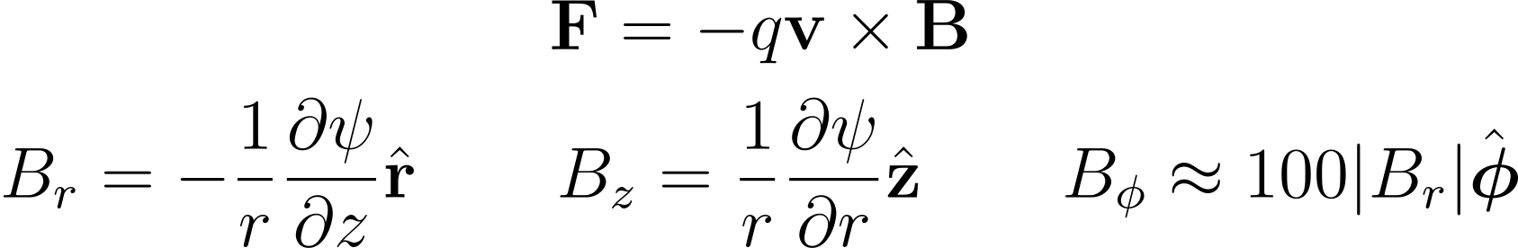
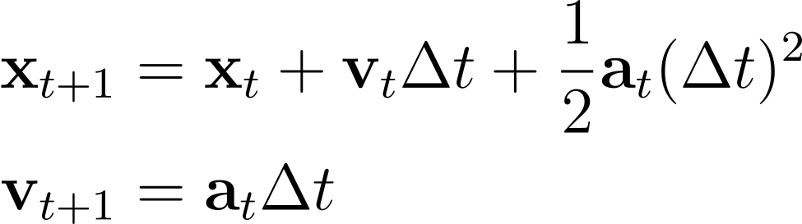
Simulation
Plasma motion dictated by Lorentz force

Slide 10
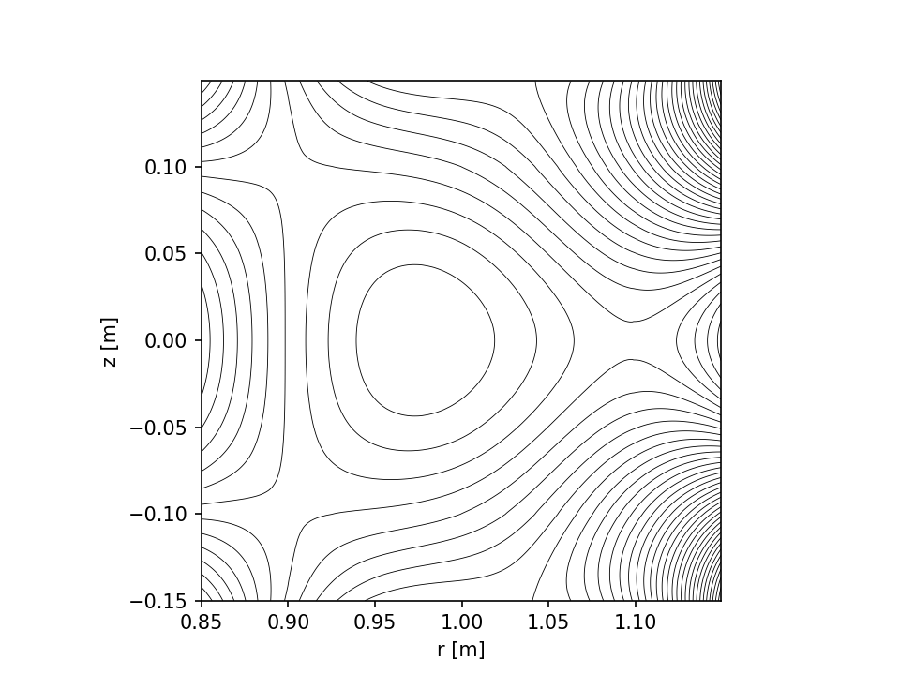
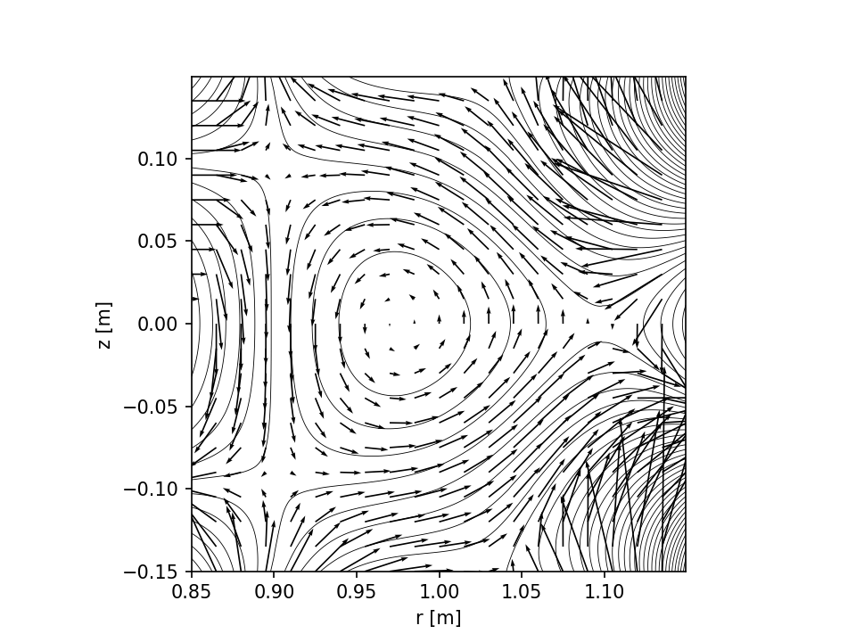
Simulation
Resultant magnetic field
Function implementation in Python and Numba
Customizable with the following parameters
Initial position | Initial velocity | Time step duration | Number of time steps

Slide 11

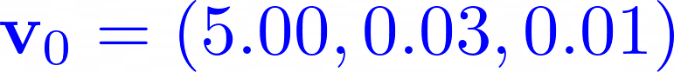
Simulation
CANNOT INCLUDE VIDEO HERE
It will make the file size too large for GitHub
Please see the ‘example_plots’ directory or the
README.md File for an example of this simulation

Slide 12
Thank you

